Slide 1
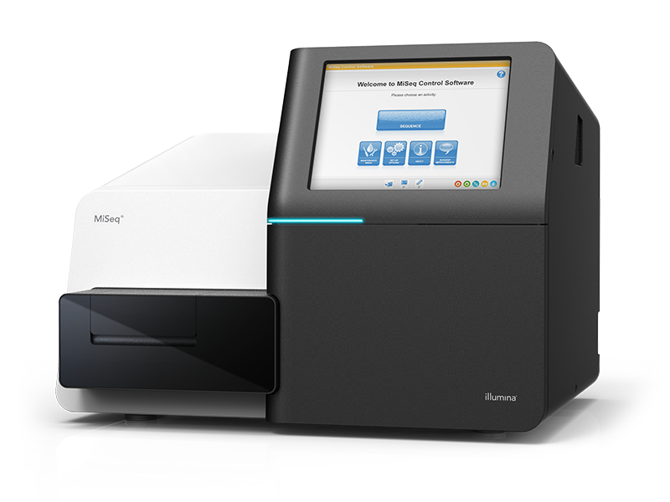
MiSeq Loading
A step-by-step guide
Rapid Response – Revised 01/12/2026

Slide 2
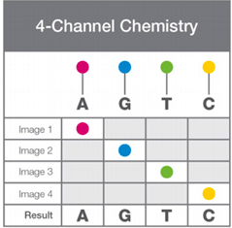

4-channel system (4 dyes)
1 - 24 Million reads
2 x 300 bp
Max 600 cycles
Run 4-55 hrs
Sequencer takes four images per cycle
Applications: small whole genomes (microbiome), targeted genes, 16S metagenomics
Handles low diversity runs well

Slide 3
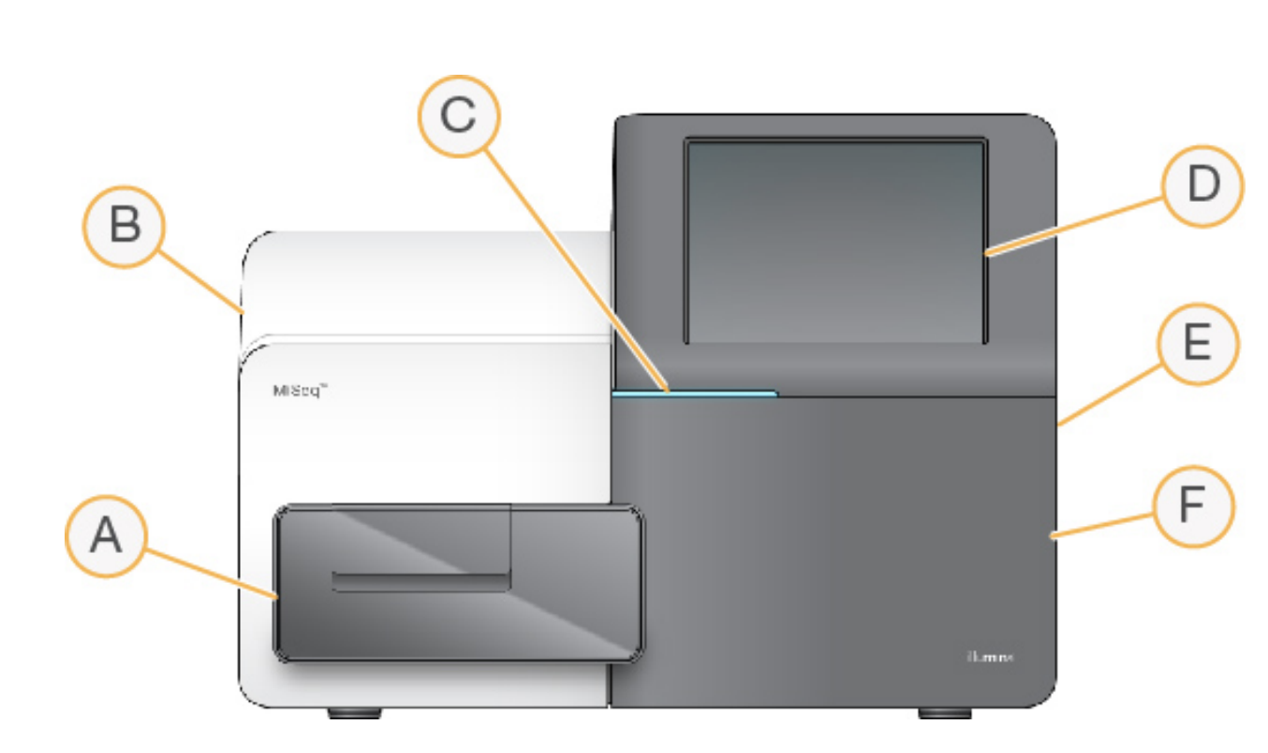
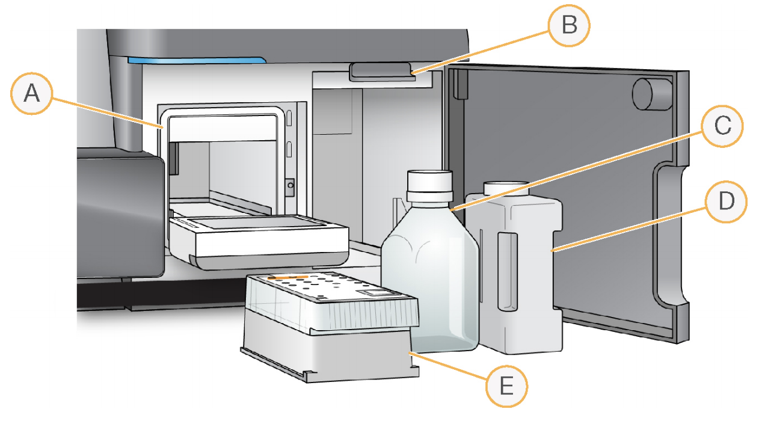
Instrument Components
Flow cell compartment
Enclosed optics compartment
Status bar
Touch screen monitor
External USB ports
Reagent compartment
Reagent chiller
Sipper handle
PR2 bottle
Waste bottle
Reagent cartridge
b
a
c
d
e

Slide 4
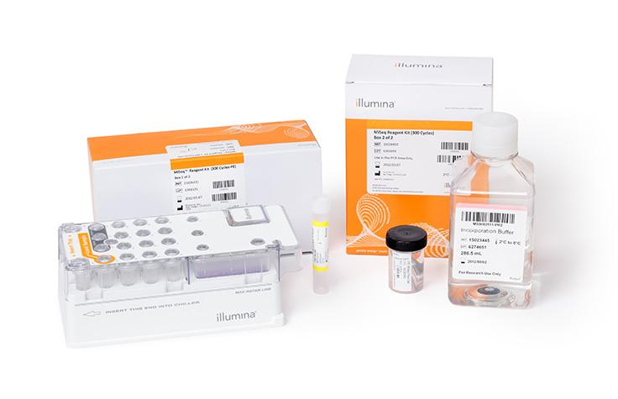
MiSeq Kit
Incorporation buffer (PR2)
(stored in 4°C)
Hybridization buffer
(HT1)
Flow cell in buffer (stored in 4°C); requires 2-3x washes with DI, followed by ethanol wipe, and drying of the flow cell with a Kimwipe
Reagent cartridge (stored at -20°C)

Slide 5
Sequencing Kits and Loading Concentrations
MiSeq V2 (V2 - 12M, Micro- 4M, Nano-1M)
Available in 50, 300, 500 cycles kit
Our optimized loading concentration: 10pM in 600µL
Cluster Density Goal: 800-1000/mm²
MiSeq V3 (24M)
Available in 150, 600 cycles kit
Our optimized loading concentration: 12pM in 600µL
Cluster Density Goal: 1000-1200/mm²

Slide 6
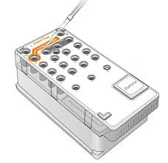
Before Loading
Thaw Reagent Cartridge
Overnight in 4ºC or water bath (room temp ~1 hr)
Take out Flow Cell and Incorporation Buffer from 4ºC
At least 30 minutes before loading to equilibrate to room temperature
Invert the cartridge 5 times to mix - avoid making bubbles
Carefully pierce foil (well #21) with a pipette tip once ready to load the diluted library into cartridge

Slide 7
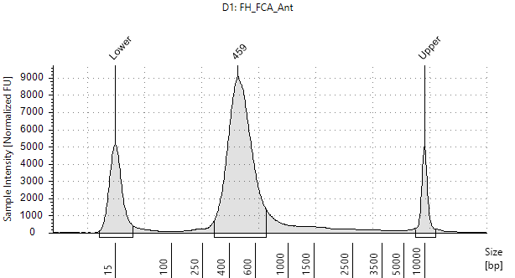
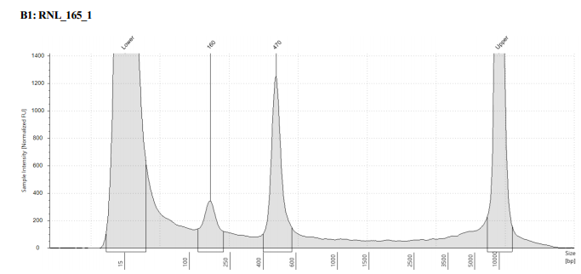
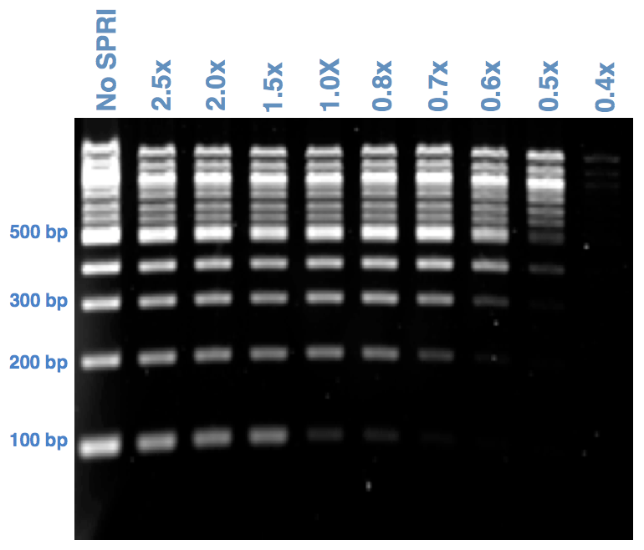
Library Distribution
Good Sample
Bad Sample
Library Distributions
Average fragment size should be 300-600 bp
Fragment that is 300 base pairs long has about 150 base pairs of adapter sequences
Long enough to run up to PE 150
Adapter Dimers (~140 bp) are bad because they preferentially cluster to the flowcell
Results in inaccurate loading
A small percent of dimers will take up a significant proportion of reads.
SPRI Select
Notes:
QC methods for library visualization - TapeStation or Bionalyzer. Library concentration may be too low for a gel.

Slide 8
Denature and dilute library
Quantify sample pool by bioanalyzer/tapestation and qPCR (if possible)
Loading concentration can be variable between MiSeqs (keep a log)
1-5% PhiX recommended (15-20% for amplicons)
5µL Sample Pool (4 nM)
20 pM pool
10pM- 12pM Final pool
Denature with 5µL 0.2N NaOH for 5 minutes. Dilute pool to 20pM by adding 990µL of HT1
Further dilute 20pM pool with HT1 and spike in denatured PhiX. Final Volume needed is 600µL

Slide 9
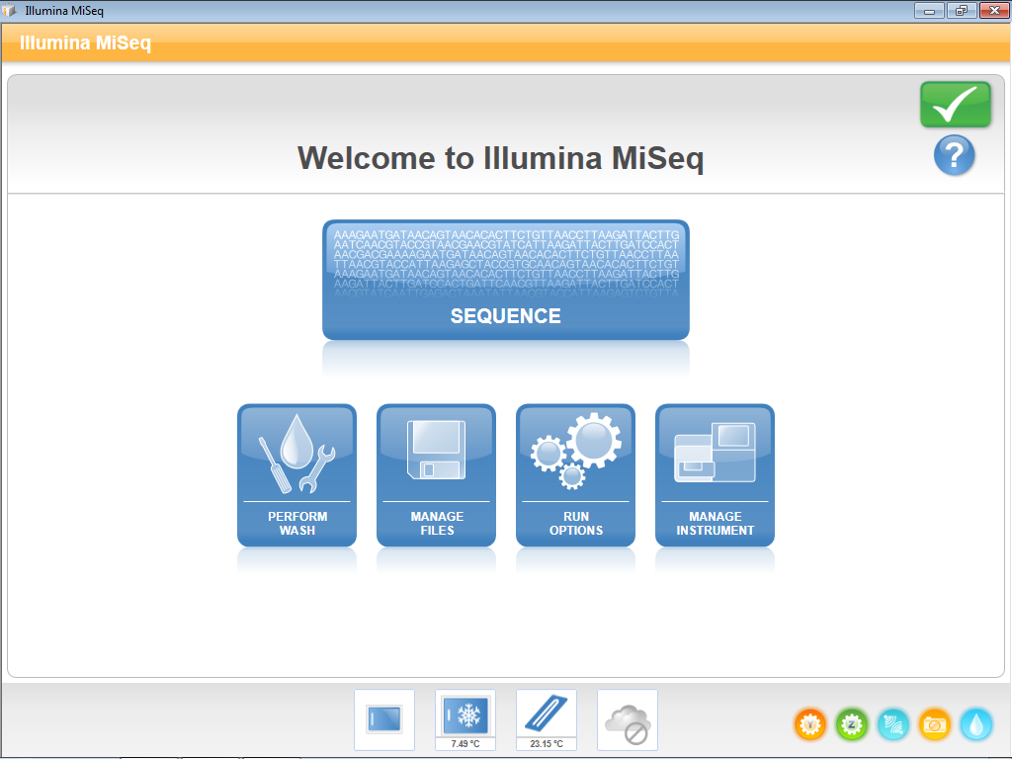

Slide 10
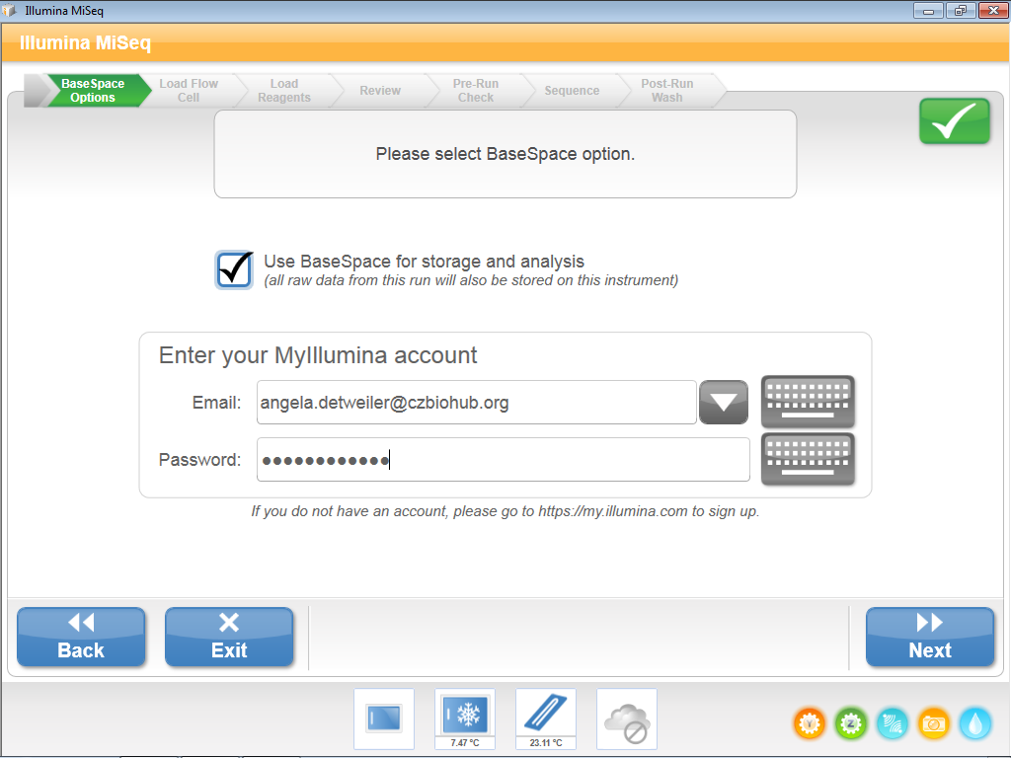
Log into BaseSpace, then click Next.

Slide 11
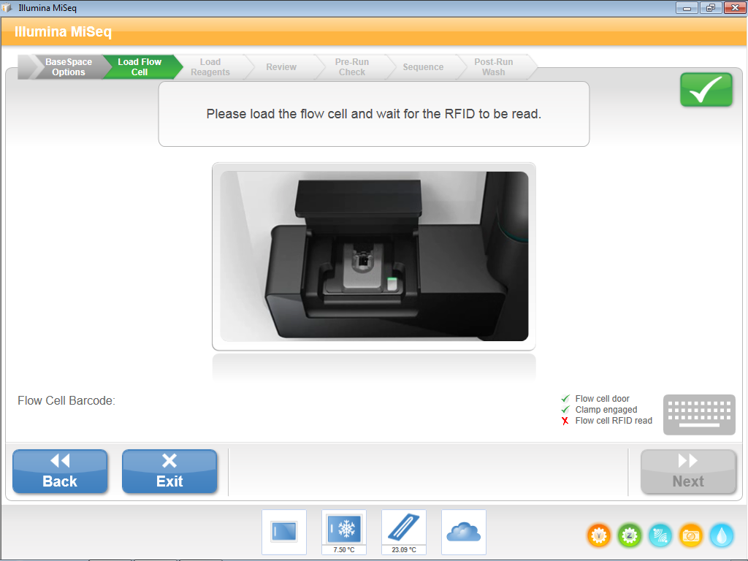
Press the white release button to open the flow cell clamp (1). Seat the flow cell and close the clamp (2). Close the flow cell compartment door (3). Once all items , click “Next”.
3
1
2

Slide 12
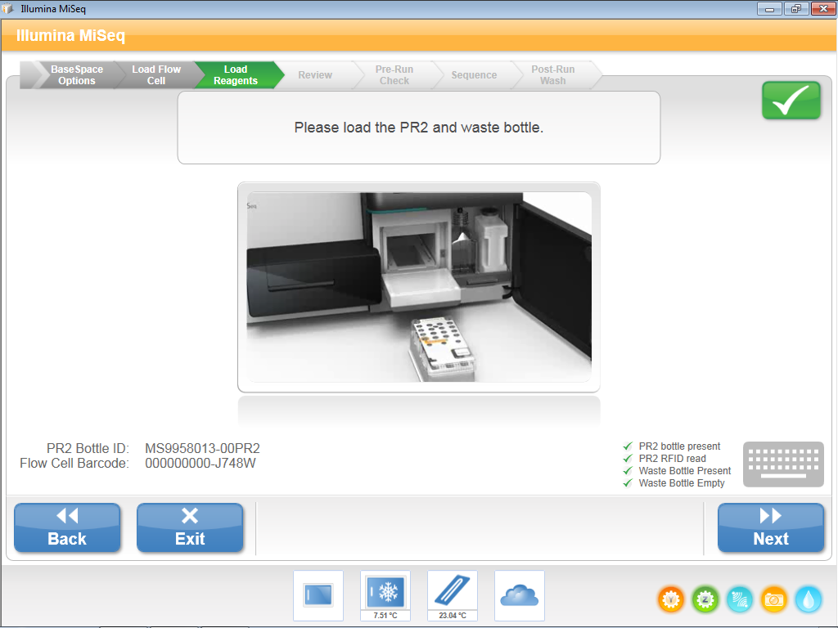
Remove/dispose of spent reagents and return the empty waste container. Remove the wash PR2 bottle and load the new buffer. Once all items , click “Next”.
*Make sure that the sipper handle is down after inserting the PR2 and waste bottle. This will also come handy when troubleshooting.

Slide 13
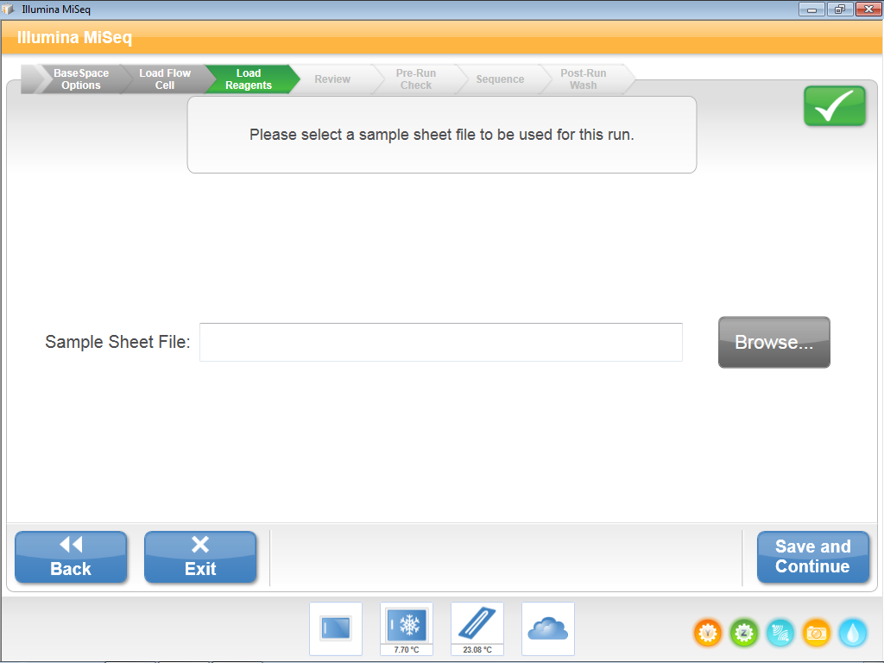
The MiSeq requires that the user upload a sample sheet. At CZ Biohub, we download the sample sheet from gDrive to the Sequencer Desktop. The sample sheet name needs to be changed to the reagent cartridge ID (e.g. “MS3046361-600V3”).
Browse for the location of the file.

Slide 14
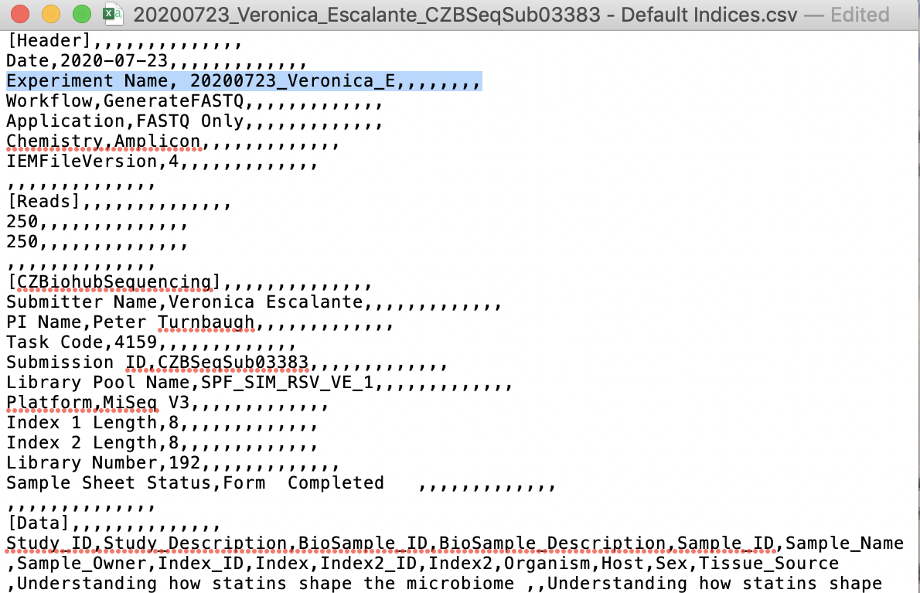
Samplesheet
Make sure to add “Experiment Name, XXXX,,,,,,,,” in line 3 as highlighted in the sample sheet example here. This will name the run on BaseSpace.
Sample sheet example

Slide 15
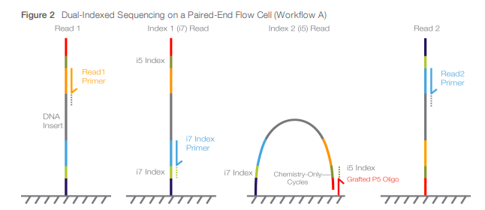
Index Reads
When preparing a sample sheet for a MiSeq run-
I7 index (Index 1) sequence is the reverse complement of the ordered sequence
I5 index sequence (Index 2) is the sequence that you ordered
P5
I5 index
Read1 Primer
Read2 Primer
I7 index
P7
Illumina Sample sheet documentation

Slide 16
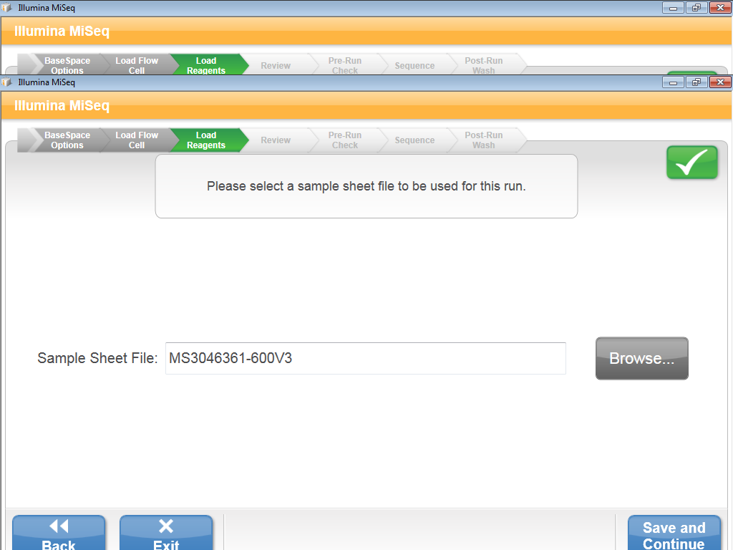
Once the sample sheet is selected, click “Save and Continue”

Slide 17
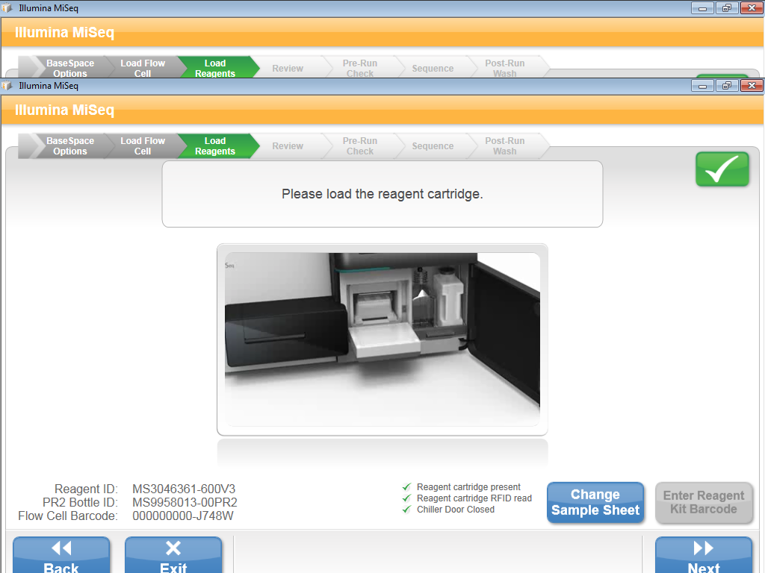
Finally remove the the wash cartridge, and slide in the new reagent cartridge. Close the reagent cartridge doors. Once all items , click “Next”.

Slide 18
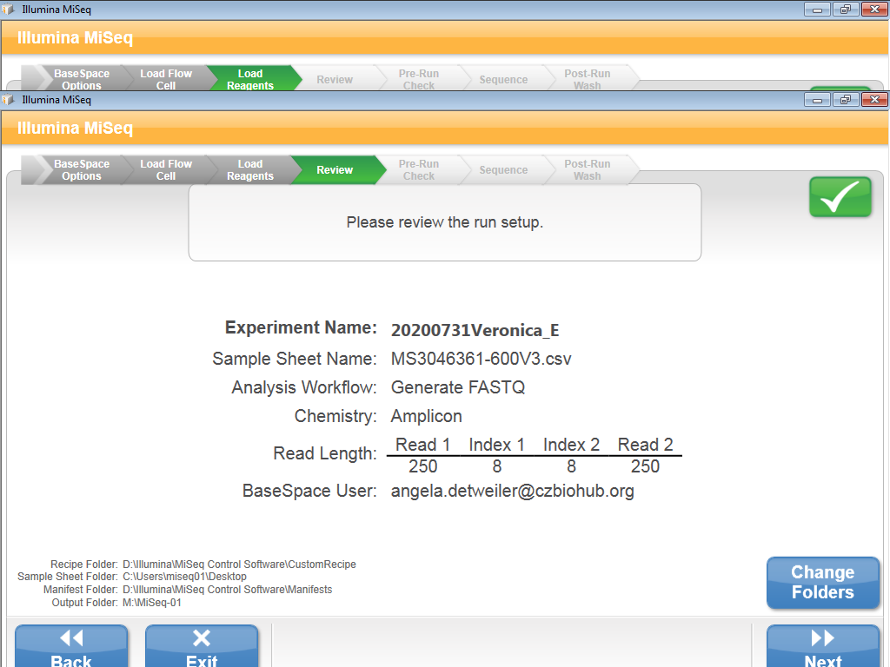
Review the run setup information pulled from the uploaded sample sheet.
If the Read or Index length needs to be updated, go back to the sample sheet, make changes and re-upload the sample sheet.
Click “Next”.

Slide 19
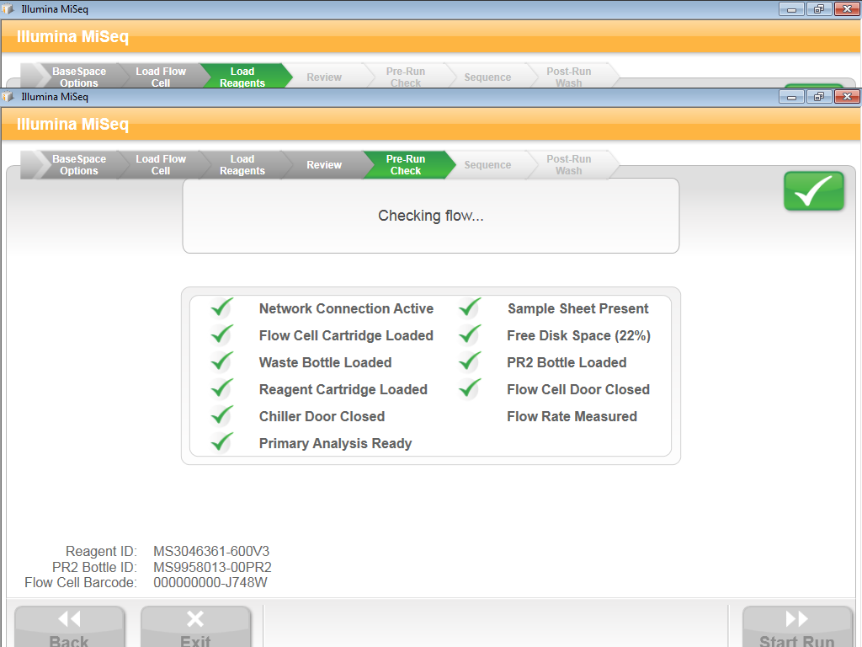
The pre-run check will take a few minutes. Once all items , click “Start Run”.

Slide 20
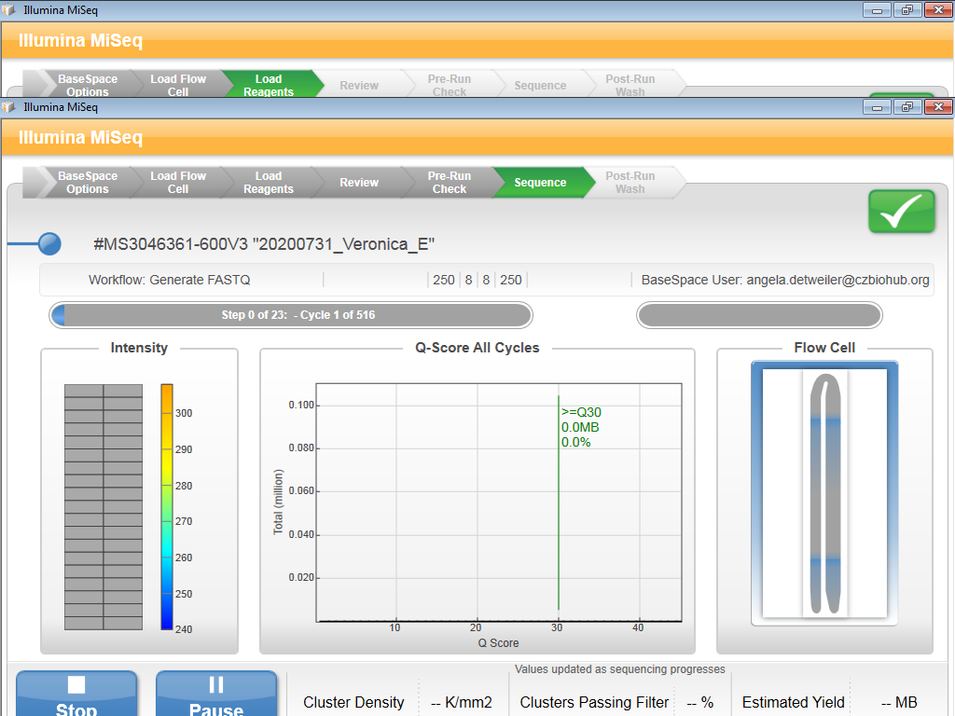
Cluster density and PF% metrics will become available after 20 and 25 cycles, respectively.
MiSeq runs can last from 4-56 hrs depending on the kit.

Slide 21
Perform Wash

Slide 23
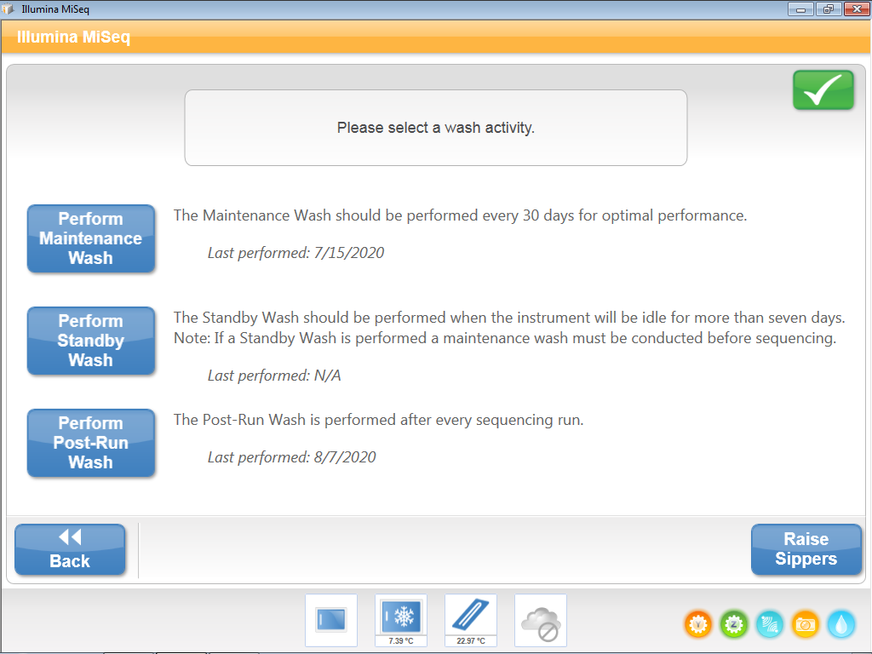
Wash Types
Maintenance Wash: Once every month (~90mins)
A series of three wash steps with 0.5% Tween20
Stand by Wash: Only if machine will be idle for for more than a week.
A series for two washes with 0.5% Tween20
Post-Run Wash: Mandatory after every run with 0.5% Tween20
When troubleshooting, you may need to raise the sippers manually

Slide 24
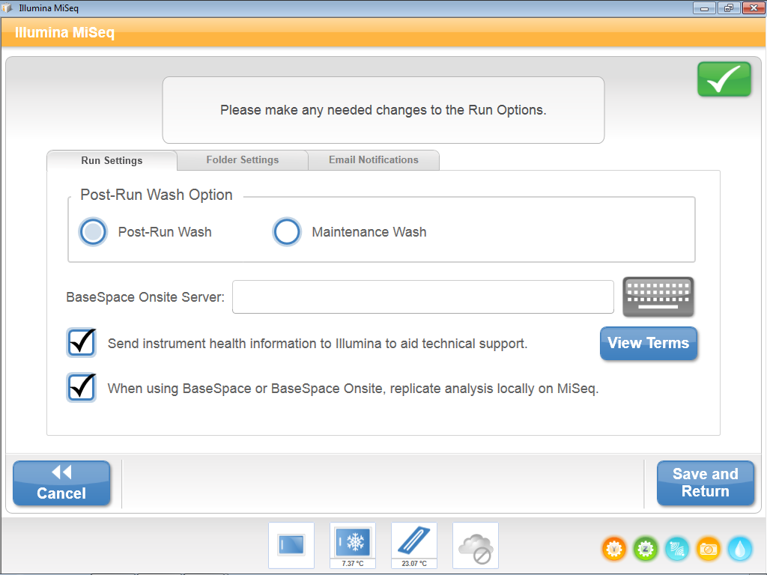
Run Options

Slide 25
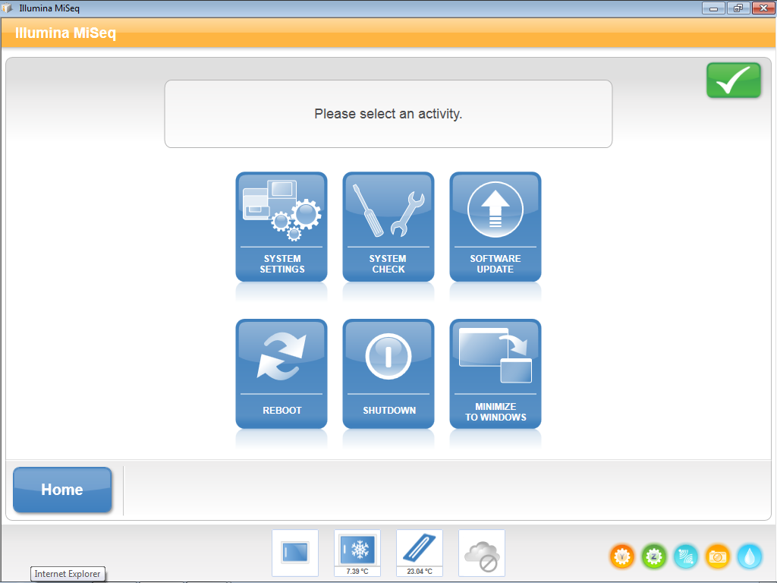
Manage Instrument

Slide 26
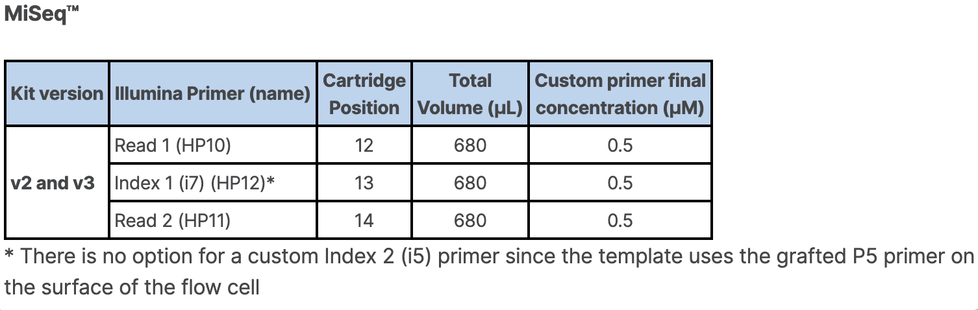
Custom Primers

Slide 27
MiSeq Installation
For MiSeq installation instructions contact your Illumina Representative.
For instrument calibration you will need an optical flow cell to run the “Optics Test” in System Check.
MySeq System Prep Guide - https://support.illumina.com/content/dam/illumina-support/documents/documentation/system_documentation/miseq/miseq-site-prep-guide-15027615-f.pdf
MiSeq System Guide - https://support.illumina.com/content/dam/illumina-support/documents/documentation/system_documentation/miseq/miseq-system-guide-for-miseq-reporter-1000000061014-00.pdf
MiSeq Denaturation Guide - https://support.illumina.com/content/dam/illumina-support/documents/documentation/system_documentation/miseq/miseq-denature-dilute-libraries-guide-15039740-10.pdf

